Slide 1
2022-23 Body Fat Testing
2022-23 IHSA Rules Interpretation Presentation

Slide 2
Exercise Physiologist
ISAK Certified Anthropometrist (Level 3)
IHSA Body Fat Instructor Since 2002
Owner of Goldstandard Systems Inc.
Kelley Altom M.S.Ed, Course Instructor

Slide 3
Purpose of Re-Certification
The purpose of the IHSA Body Assessor Re-Certification Home study course:
  Ensure continued competence as an IHSA Certified Body Fat Assessor
  Provide information needed to pass the Body Fat Assessor exam

Slide 4

Introduction

Slide 5
Purpose/Goals
Purpose:
  Prevent unhealthy weight management practices in student athletes that compete in the sport of wrestling through education and best practice
Goals:
  Elimination of all weight control practices that could potentially risk the health of wrestlers
  Focus on competition, not weight loss
  Recommendations should be practical, enforceable, and scientifically based

Slide 6
Regulations
To accomplish these goals, standards have been established that require each wrestler to undergo a comprehensive preseason evaluation to assess the following:
  Hydration Status
  Body Weight
  Percent Body Fat

Slide 7
Regulations
The data from these assessments are entered into a series of equations so that the following safeguards can be determined for each wrestler:
  Minimum Wrestling Weight (MWW)
  A safe weight loss descent plan (1.5% Rule)
  A weight class cycling limit

Slide 8
Regulation
Minimum Wrestling Weight (MWW) Defined: The lowest weight that a wrestler can maintain indefinitely without adverse effects on health and performance. (American Academy of Pediatrics & American College of Sports Medicine)
Regulation: MWW is based on 7% body fat for males and 12% body fat for females

Slide 9
The Regulation
The initial body fat assessment will require all wrestlers to be assessed using the 3- site Skinfold Technique.
All wrestlers must have their minimum wrestling weight established prior to any interscholastic competition.
ONLY Certified IHSA Body Fat Assessors can determine a wrestlers MWW.

Slide 10
Determining MWW: Scenario 1
Rule: If the predicted weight is exactly that of one of the weight classes, that weight class shall be the wrestler’s minimum weight class.
Example: If a wrestlers MWW is calculated at 132.0 lbs.
WEIGHT CLASSES
106.0 LBS 152.0 LBS
113.0 LBS 160.0 LBS
120.0 LBS 170.0 LBS
126.0 LBS 182.0 LBS
132.0 LBS 195.0 LBS
138.0 LBS 215.0 LBS
145.0 LBS 285.0 LBS

Slide 11
Determining MWW: Scenario 2
RULE: If the weight class falls between two weight classes, he/she must wrestle at the higher weight class.
Example: If a wrestlers MWW is calculated at 132.2 lbs.
WEIGHT CLASSES
106.0 LBS 152.0 LBS
113.0 LBS 160.0 LBS
120.0 LBS 170.0 LBS
126.0 LBS 182.0 LBS
132.0 LBS 195.0 LBS
138.0 LBS 215.0 LBS
145.0 LBS 285.0 LBS

Slide 12
Determining MWW: Scenario 3
RULE: Any wrestlers whose % body fat is determined to be below the minimum threshold they will not be allowed to lose additional weight and their minimum weight class will be determined using the same criteria as scenario 2.
Example: If a wrestlers % body fat is 6.5% and MWW is calculated at 132.2 lbs.
WEIGHT CLASSES
106.0 LBS 152.0 LBS
113.0 LBS 160.0 LBS
120.0 LBS 170.0 LBS
126.0 LBS 182.0 LBS
132.0 LBS 195.0 LBS
138.0 LBS 215.0 LBS
145.0 LBS 285.0 LBS

Slide 13
Maximum Allowable Weekly Weight Loss
(1.5% Decent Rule)
RATIONALE: Rapid weight loss can be unhealthy & unsafe.
REGULATION: Maximum weekly wt. loss is set at 1.5% of wrestlers body weight starting from the date of the initial body fat assessment.
A wrestler will NOT be allowed to wrestle at any weight class below their initial weight class until the date specified on the body fat results sheet provided by the IHSA.

Slide 14
Weight Cycling: Limiting the Ups and Downs
REGULATION: If a wrestler weighs in two weight classes above the lowest certified weight they have competed at, then the wrestler will automatically be recertified at one weight class above that certified weight for the remainder of the season.
Example: If a wrestler has competed at 132 wt. class they are eligible to compete at 138 wt. class (because its only one weight class up). If that wrestler weighs in at 145 (which is two weight classes above the 132 wt. class) that wrestler may not weigh in lower than 138 the remainder of the season.

Slide 15
Time Period for Scheduling the Body Fat Assessment
Measurements may begin on Monday, week 19 in the IHSA calendar (Nov. 7th, 2022)
Competition begins on Monday, week 21 in IHSA calendar (Nov. 21st 2022
Final appeal must be filed by Friday, week 24 in IHSA calendar (Dec. 16th)
Measurements must be complete by Friday of Week 30 of the IHSA calendar (Jan. 25, 2019)
REMEMBER a wrestlers MWW must be established prior to competition

Slide 16
IHSA Certification Scheme
Certification Scheme & Fees
Attend a 3-hour “live” training course every 4 years (Fee $35) and;
Complete an annual “Home Study" course and exam (Fee $10) in the years between the “live” training courses.

Slide 17
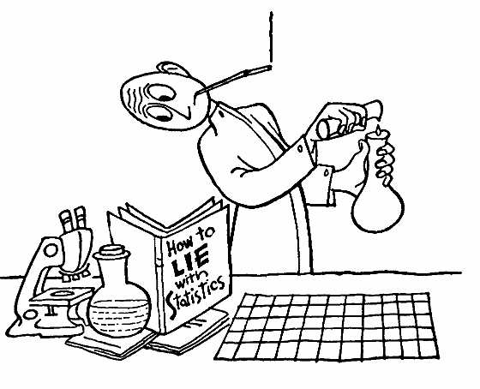
Basic Statistics
The best strength of a method is knowing its weakness.

Slide 18
Basic Statistics
Components of measurement quality
Sources of Measurement error
Quantifying the level of uncertainty

Slide 19
5 Components of Measurement Quality
Objectivity
Precision
Reliability
Accuracy
Validity

Slide 20
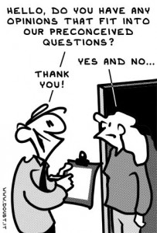
Measurement Quality: OBJECTIVITY
Measurements that lacks bias, judgment or prejudice
Example: Following Standardized Procedures vs. Eye balling/guessing

Slide 21
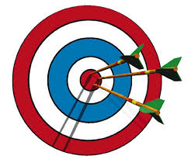
Measurement Quality: PRECISION
The closeness of two or more measurements
Intra-test Variability
High precision = Low variability (visa versa)

Slide 22
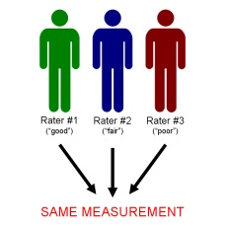
Measurement Quality: RELIABILITY
The degree to which the result of a measurement can be depended on to be consistent
Inter-tester Variability
Results are reliable when measurements can be repeated by you as well as by others independently

Slide 23

Measurement Quality: ACCURACY
The extent to which a measured value corresponds to the real value
BUT…what is the real value in Anthropometry?

Slide 24
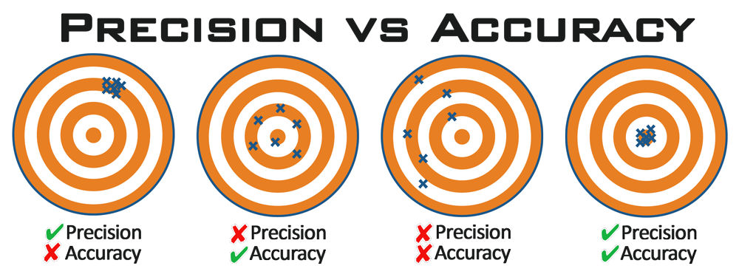
Measurement Quality

Slide 25

Measurement Quality: VALIDITY
The extent to which a measurement actually measures the variable under study

Slide 26
Measurement Goals
The measurement goals of an IHSA Certified Body Fat Assessor:
TO ACHIEVE HIGH LEVELS OF PRECISION, RELIABILITY AND ACCURACY, USING A VALID MEASURING TECHNIQUE

Slide 27
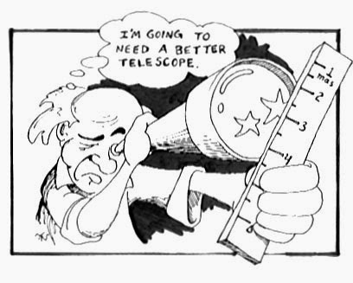
All Measurements Are Subject To Error

Slide 28
Sources of Measurement Error
ERROR
BIOLOGICAL MEASUREMENT EQUIPMENT
VARIABILITY TECHNIQUE CALIBRATION

Slide 29
Biological Variability
Sources of Error We Cannot Control
  Skin Thickness is negligible or a constant fraction of skinfold
  Adipose tissue compressibility is constant
  Fixed adipose tissue patterning
  Menstrual Cycle

Slide 30
Sources of Error You Can Control
Measurement Techniques
Measurement Procedures
Meticulous land marking
Following standardized techniques (ISAK)
Comparing measurements to certified Anthropometrist (level 3 or 4)
Practice on all shapes and sizes (min. of 20 athletes within acceptable error margin)
Time of day/ between measurements
Environmental conditions
Athlete presentation
Writing data correctly (1/7’s, 4/9’s, 0/6’s)
Clear pronunciation

Slide 31
Sources of Error You Can Control
ISSUES WITH ASSESSING LARGE TEAMS
Assessor fatigue & reduced motivation over time
Do not underestimate time required for each assessment
Set aside at least 10-15 minutes per assessment
Recruit other potential assessors from your school to get certified and/or recruit other IHSA Certified Body Fat Assessors to help

Slide 32
Sources of Error You Can Control
Equipment Quality
Calibration & Maintenance
Quality Equipment/Instrument
Proper maintenance of Equipment/Instrument
Calibration of Equipment/Instrument

Slide 33
Quantifying Uncertainty & Acceptable Error Margin
IHSA Certified Body Fat Assessors must demonstrate they can measure skinfolds within an acceptable error margin
Provides an objective method to evaluate competency
IHSA has chosen a standard error of 1mm as the acceptable error margin in repeated skinfold measures
IHSA is considering other options (such as 10% error margin)

Slide 34

Ethics & Professional Responsibility
Moral principles that govern a person's behavior or “code of conduct”

Slide 35
Professional Responsibility Statement
All IHSA Certified Body Fat Assessors will respect the athletes “right to privacy” and the confidentiality of all the data collected during the assessment.
Assessors are expected to provide the highest professional and ethical conduct relative to performing assessments on the student athletes.
Independent circumstances may require assessors to make professional judgments to further validate the assessment process; therefore, mastering assessment skills and understanding the nature of the Wrestling Weight Certification Program is essential for the success of the program.

Slide 36
Ethics/Professional Responsibility
Protect the athletes right to privacy
Confidentiality of data
Personal space
Cultural, gender and para-sport issues
Eliminate unnecessary comments or gestures
Adherence to personal hygiene practices
Room Temperature should be set at comfortable temp

Slide 37
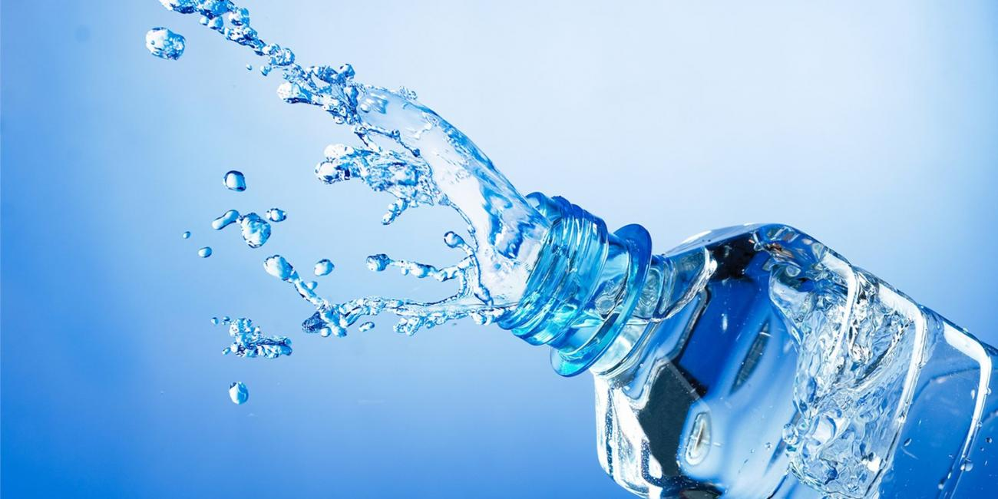
Step One in the Assessment Process
Assessing Hydration Status
  Rationale
  SG Terms
  Equipment & Supplies
  Calibration
  SG Procedures
  Trouble Shooting

Slide 38
Assessing Hydration Status Rationale
Hydration is an important component of the Wrestling Weight Control Program for two primary reasons:
  A well-hydrated state is essential for both health and performance of any student athlete.
  Hypohydration compromises the accuracy of the body composition assessment.

Slide 39
Hydration Status Terms
Euhydration refers to normal state/range of body water content
Hypohydration refers to the STATE that occurs when your body fluid levels are inadequate for normal functioning.
Dehydration refers to the PROCESS of losing body water.
Athletes need to take a proactive effort to ensure adequate replenishment occurs.

Slide 40
How is Hydration Status Assessed
Laboratory Methods
Isotope dilution
Neutron activiation analysis
Plasma Osmolarity
Bioelectical impediance spectrometry (BIS)
URINE SPECIFIC GRAVITY
Field Methods
Urine color
Body weight changes
Urine frequency
Rating of thirst

Slide 41
Urine Specific Gravity
What is Urine Specific Gravity?
  Urinary specific gravity (SG) is a measure of the concentration of solutes in the urine. SG refers to the density (mass per volume) of a sample in comparison with distilled water.

Slide 42
Urine Specific Gravity: Measurement Ranges
SG of water is 1.000g/ml.
SG is always greater than 1.000g/ml. The more concentrated the urine, the higher the urine specific gravity.
The reference range of SG in humans is 1.002-1.030g/ml (although it can go higher)

Slide 43
Urine Specific Gravity: Regulation
SG is simply a pass/fail assessment based on the specific gravity level equal to or less than 1.020g/ml.
If an athlete fails the SG test, the assessment process is ended and the athlete will not be eligible for reassessment for 24 hours.
Hydration testing MUST be done immediately prior to and at the same site where the body composition testing occurs.

Slide 44
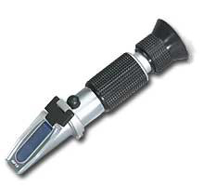
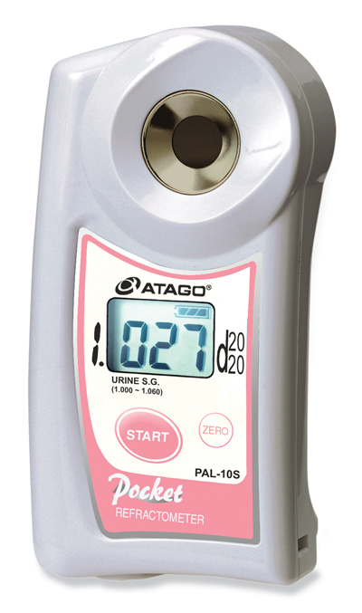
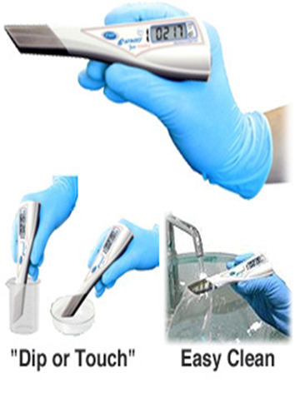
Refractometer is Used to Assess Urine Specific Gravity
Optical/Analog
Digital

Slide 45
USG Supplies List
Urine Collection Cups
Latex-Free Gloves
Pipettes/Straws
Bio-hazard Waste Bags & Waste Basket
Copies of “Clean Catch” procedures for males & females
Hand Sanitizer
Towelettes
Mild soap and water solution, Isopropyl Alcohol to clean
Distilled Water
Soft Lint & Residue-free cloth (Kimwipes)
Markers/pens
Clipboard
Tape
Color dye

Slide 46
Refractometer Calibration
Refer to your refractometer operation manual for your model's specific calibration instructions. If you do not have the manual, here are basic calibration instructions. (Note that while distilled water works for most models, a few models require calibration fluid. The procedure is the same whether you use distilled water or calibration fluid.)

Slide 47
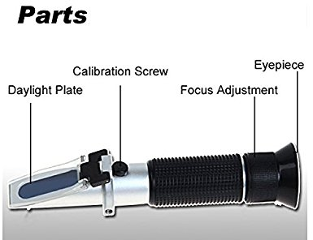
OPTICAL Refractometer Calibration

Slide 48
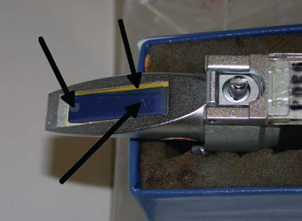
OPTICAL Refractometer Calibration
Check for damages (scratches, separations, detached prism)

Slide 49
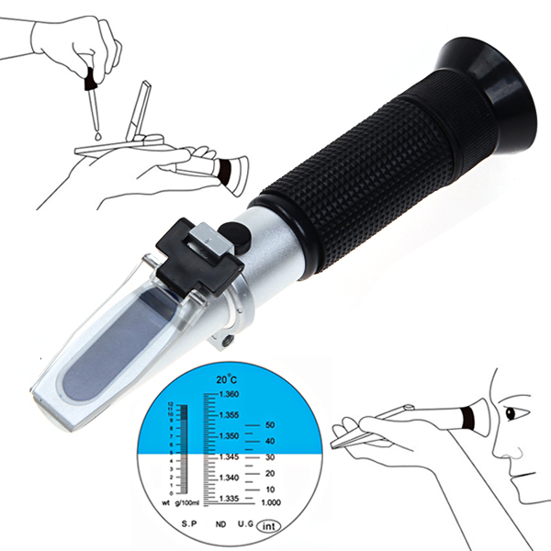
OPTICAL Refractometer Calibration
Open the daylight plate and place 2-3 drops of distilled water on the main prism. Close the daylight plate so the water spreads across the entire surface of the prism without air bubbles or dry spots.
Hold the daylight plate in the direction of a light source and look into the eyepiece. You will see a circular field with graduations down the center (you may have to focus the eyepiece by turning it to see the graduations clearly). The upper portion of the field should be blue, while the lower portion should be white. Read the specific gravity level off the scale - the point where the contrast line (difference between light and dark areas) crosses the scale.

Slide 50
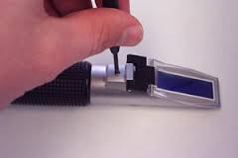
OPTICAL Refratometer Calibration
While looking into the eyepiece, adjust the Calibration Screw (on the top of the refractometer) until the boundary between the upper blue field and the lower white field meet exactly on the 0.0° line if it is not already perfectly lined up.
CAUTION: Be careful turning the scale adjustment screw. If it is excessively turned, it may cause breakdown of the refractometer!
Once Calibration is complete dry the prism and daylight plate with soft non-abrasive cloth

Slide 51
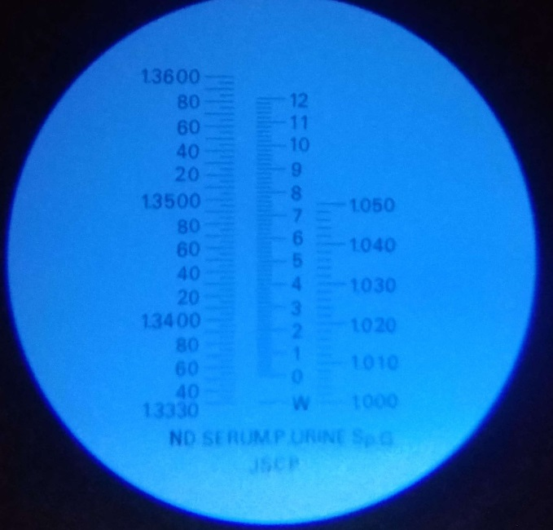
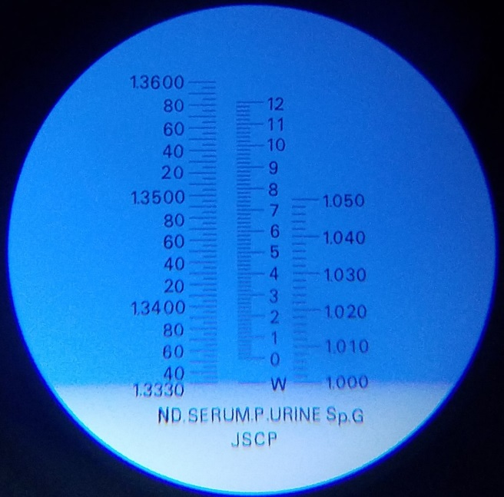
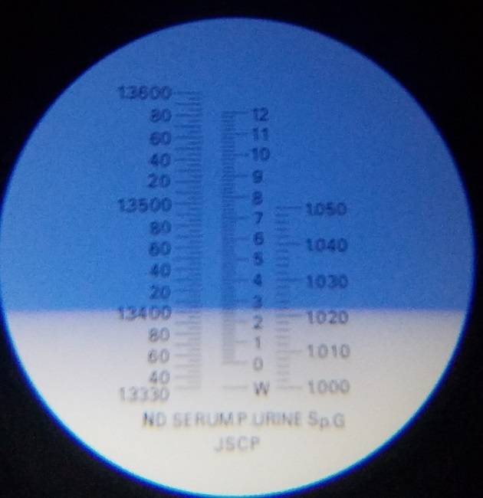
OPTICAL Refractometer Examples
NO FLUIDS WATER URINE
1.000g/ml 1.022g/ml

Slide 52
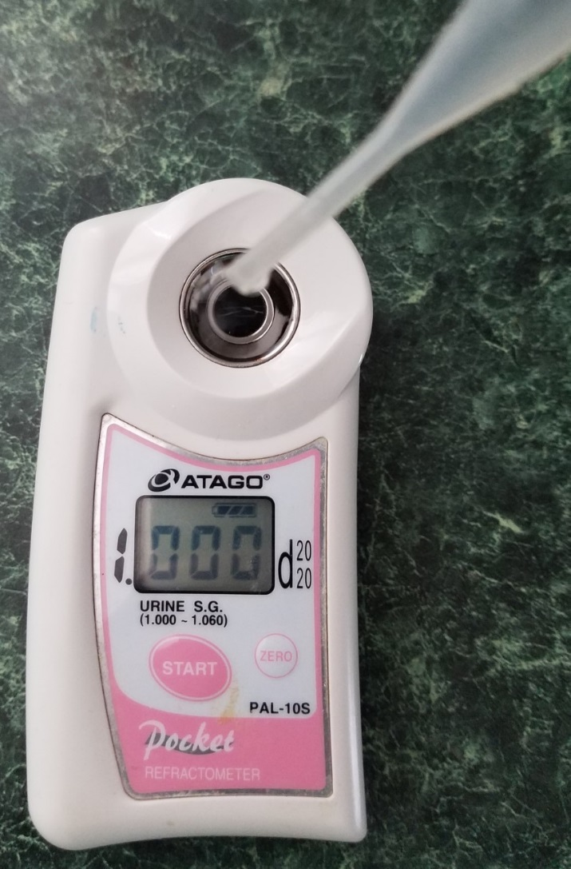
DIGITAL Refractometer Calibration
Clean the prism surface
Place distilled water onto the prism surface
Press the START key. The measured value will be displayed
If the display indicates “1.000", the refractometer is calibrated and ready for use
Wipe the water off of the prism with a lint free tissue

Slide 53
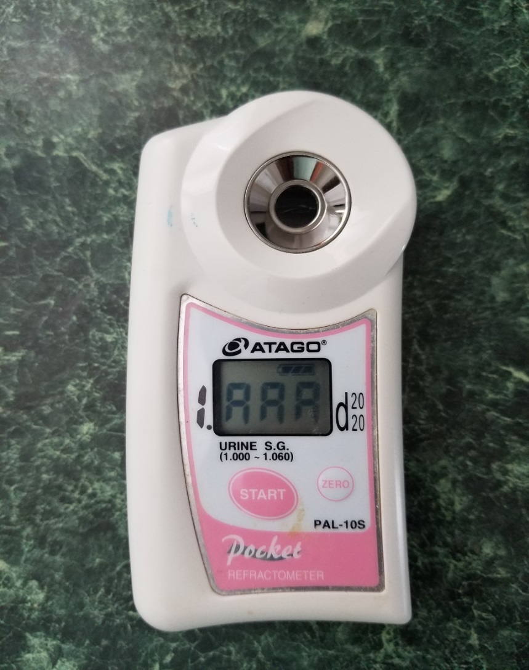
DIGITAL Refractometer Calibration
If the indicated value is not “1.000” press the ZERO key and wait a couple seconds for calibration.
When “1.000" is displayed, the refractometer is calibrated and ready for use.
Dry the prism surface by wiping with a tissue.
If an error code is displayed look up the code in your user manual and follow the trouble shooting instructions.

Slide 54
Caring for Your Precision Instrument
Always store your calipers in a protective case.
When not in use, be sure to return the caliper to its storage case.
Do not use solutions that the refractometer is not made for.
Do not exceed the measurement range of the refractometer.
Store your refractometer in a location that has a relatively constant temperature. Extreme temperatures can compromise the functioning of the refractometer.
Be sure to check the caliper’s calibration periodically and follow the manufacturer’s instruction for recalibrating if necessary.
Protect your dial calipers from dust which can get inside the dial and cause inaccurate readings.
Never drop or throw your caliper.
Don’t lay the caliper in any kind of debris (metal chips or grinding grit).

Slide 55
Prior to Scheduling Body Fat Assessment
To ensure privacy and confidentiality of data reserve a washroom dedicated only to wrestlers to provide a urine sample
Reserve a second private area nearby where the body fat test can take place
Distribute “How to Prepare & Pass the Hydration Assessment”
Check inventory to ensure all equipment & supplies are readily available and in working order
Coordinate dates and times to perform the assessments with assistants and wrestling coach based on your availability

Slide 56
How to Pass USG Test
Eat normal diet of foods high in H2O content.
Drink Plenty of fluids (at least 8-16 eight oz cups of water) for several days prior to assessment.
Discontinue any supplements that promote dehydration 24-48 hours prior (i.e. Creatine).
Avoid foods or beverages w/ caffeine 24-48 hours prior (i.e. soda, chocolate, coffee).
Avoid vigorous activity involving sweating 24 hours prior.
Avoid early morning tests.
Distribute these hydration tips to the athlete and their parents in advance of the testing.

Slide 57
Prior to Scheduling Body Fat Assessment
RECRUIT ASSISTANTS
Assistants will help supervise the process of urine sample collection, NOT with taking any measurements
Assistants can record measurements communicated by the Body Fat Assessor
Ensure that conditions do not exist that could compromise the integrity of the urine sample collection (bulky clothes, backpacks, horseplay, etc).
Ensure personnel is in all traffic areas between the collection area and the testing area if they are in different places.

Slide 58
Urine Specific Gravity Procedures
Inform the athlete on how to collect a “clean-catch midstream urine sample”
Print out copies of the Clean-Catch Midstream Urine Sample” instructions and tape them inside the bathroom stalls for wrestlers to review
The goal of the clean-catch midstream urine sample is to avoid contamination. A contaminated specimen can produce an inaccurate result

Slide 59
Male: Clean-Catch Midstream Urine Sample
Step 1: Wash hands with soap and water, rinse and dry
Step 2: Expose penis, retract foreskin (if not circumcised) and wash the head of the penis with one anti-bacterial towelette
Step 3: Rinse penis with one sterile towelette
Step 4: Pick up collection cup container at sides. Do not touch the lid or inside the cup
Step 5: Begin by urinating a small amount into the toilet to clear urethral commensals (bacteria)
Step 6: Next, pass a portion of urine (approximately ¼ cup) into the collection container.
Step 7: When voiding is complete, athlete will give container to appropriate personnel

Slide 60
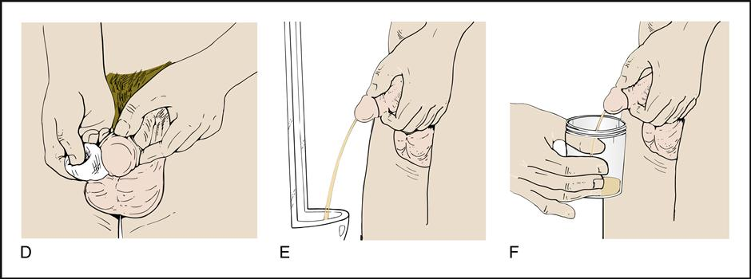

Slide 61
Female: Clean-Catch Midstream Urine Sample
Step 1: Wash hands with soap and water, rinse and dry
Step 2: Open 3-anti-bacterial and 1-sterile towelettes and place them on a clean surface
Step 3: Remove undergarments. Sit on toilet seat and swing one leg to the side as far as possible.
Step 4: Using one hand, spread the labia folds and keep them spread during the cleaning and collection of urine specimen. Wash the area from which urine is passed. Use the 3- anti-bacterial towelettes, one at a time, wiping from front to back. Rinse with one sterile towelette.
Pick up collection cup container at sides. Do not touch the lid or inside the cup
Step 5: Begin by urinating a small amount into the toilet to clear urethral commensals (bacteria)
Step 6: Next, pass a portion of urine (approximately ¼ cup) into the collection container.
Step 7: When voiding is complete, athlete will give container to appropriate personnel

Slide 62
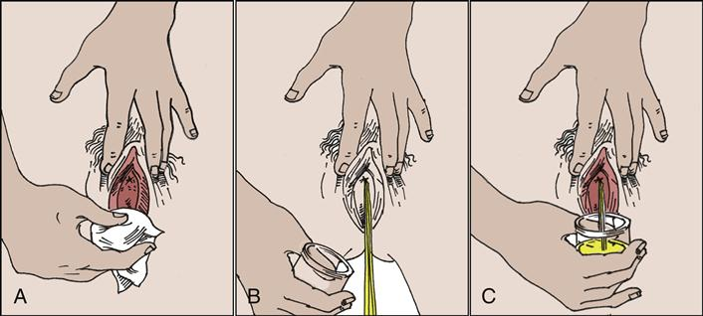

Slide 63
Urine Specific Gravity: Procedures
Mark each urine collection cup to identify the athlete being tested.
Instruct each wrestler to enter the toilet or urinal one at a time with nothing but the urine collection cup.
It is recommended that no more than THREE wrestlers be supervised at one time during the urine collection.
Allow reasonable time for the athlete to provide a sample of urine.
Wrestlers should not have access to sinks where water can be added to their samples, therefore, it is recommended that faucets are taped shut (except for one to wash hands).

Slide 64
Urine Specific Gravity: Procedures
Colored dye, tide-bowl, fruit punch packets or other agents to color the toilet water may be added so that wrestlers are not tempted to dip their cup into the toilet water.
Personnel must ensure that the wrestler has provided a sample of their own urine. Reasonable supervision is required, however, under no circumstances will personnel witness the sample going from the body into the collection container.
After collection of the urine by the athlete, appropriate personnel should ensure that the urine is warm by feel on the outside of the collection cup. If the urine is cold or suspect, reject that sample and require the athlete to provide another sample under closer supervision.

Slide 65
Determining SG: Refractometer
Use Refractometer (Optical or Digital)
Tester will use latex free gloves
Administer test ASAP after sample is collected
Use clean pipette/straw to obtain sample
Place 2-3 drops on refractometer prism
Record results….remember passing has to be between 1.002 g/ml - 1.020g/ml
Discard urine, pipette, container, cleaning supplies
Clean and dry refractometer
Re-calibrate after every 10 samples

Slide 66
Troubleshooting
Infrequent Calibration
Sample Contamination
Not cleaning the daylight plate or prism surface completely between samples
Misreading the metered scale displayed in the viewfinder

Slide 67
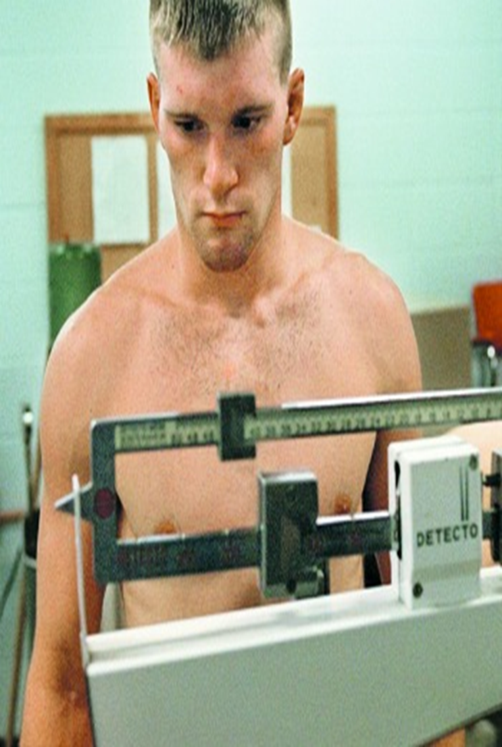
Step Two in the Assessment Process: Body Weight
Body weight scale options & requirements
Scale care & maintenance
Scale calibration locations
Proper attire
Weighing procedures

Slide 68
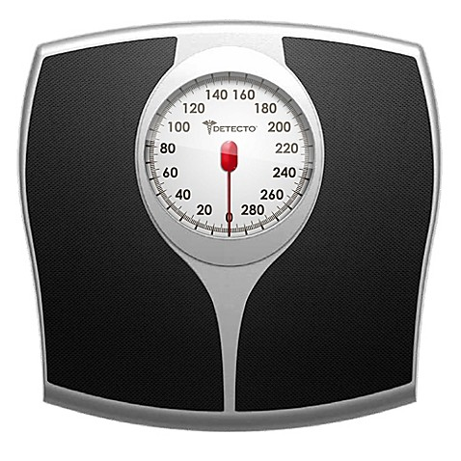
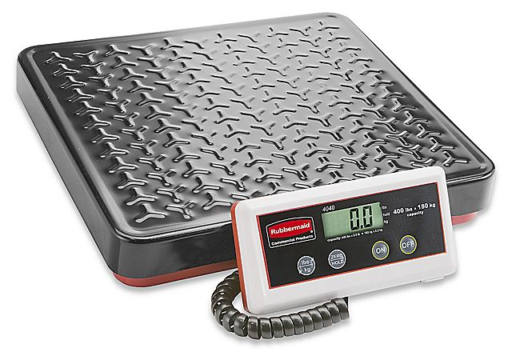
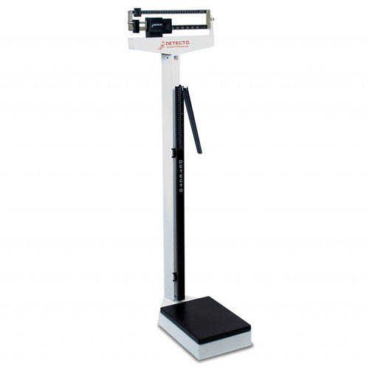
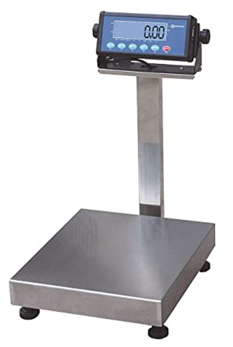
Body Weight Scale Options & Requirements
Digital Balance Beam Bench Spring
Scale Capacity: 300+ LBS
Accuracy Requirements: 0.2 LBS

Slide 69
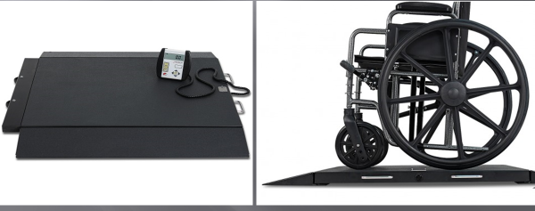
Para sport athletes (use platform scale)
Notes:
If you have a para sport athletes you should consider platform type scale. I had someone ask me this before.

Slide 70
Scale Care & Maintenance
To clean the scale, wipe surfaces with damp cloth. Never submerge the scale in water
Do not store the scale in direct sunlight or other hot places
Do not try to adjust digital/electronic scales. If adjustment is necessary, contact the manufacturer

Slide 71
Scale Calibration
Local bureau of weights and measure can calibrate equipment against criterion standards.
  Illinois Dept. of Agriculture- Weights & Measures: 801 E Sangamon Ave, Springfield, IL 62702
  Department of Business Affairs and Consumer Protection (BACP): 2350 W. Ogden Ave., 2nd Floor Chicago, IL 60608

Slide 72
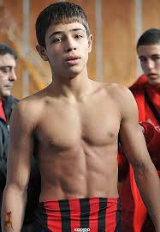
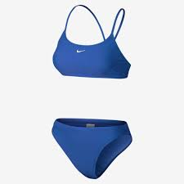
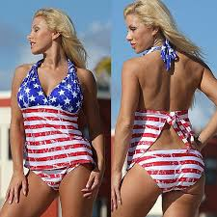
Obtaining Body Weight: Attire
  Males must wear shorts w/ t-shirt removed
  Females must wear shorts and a top that exposes the scapula
  Underwear is not acceptable attire.
  Under NO circumstances may a wrestler be weighed-in, in the nude

Slide 73
Weighing Procedure
Position the subject: in the center of the scale platform facing the recorder
Hands should be at sides, and looking straight ahead.
(BE SURE THEY ARE NOT TOUCHING ANYTHING!)
Wait for steady reading and then announce body weight to recorder

Slide 74
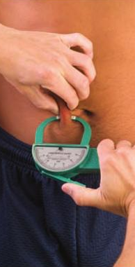
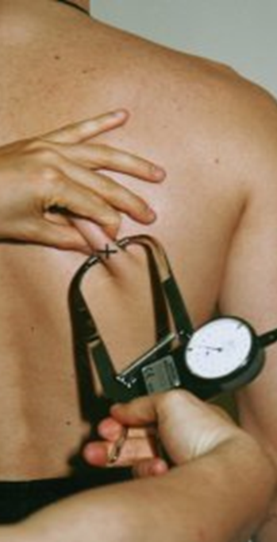
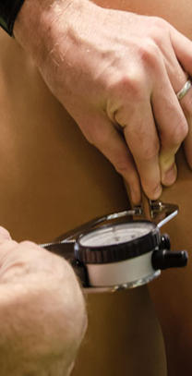
Step 3: Skinfold Assessment
Facility & Assistance Recommendations
Equipment & Supplies
Skinfold Caliper Calibration
Land marking
Skinfold Technique

Slide 75
Skin Fold Assessment: Facility Recommendations
Choose a location close to where the Hydration assessment was taken for convenience.
Assessments must be taken in a separate room or screened-off area to allow for privacy and confidentiality of data.
Ensure adequate space to easily move around the subject and manipulate the equipment.
Area should be at set at a comfortable temperature.

Slide 76

Standardized protocol
International Society for the Advancement of Kinanthropometry
Recognized as best practice protocol in Sport Sciences
Recommended protocol by the International Olympic Committee (IOC)

Slide 77
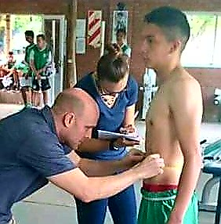
Skin Fold Assessment: Assistant Needs
Assistant should be used to help record data.
Body Fat Assessor must use clear pronunciation and the recorder must write clearly.
After Body Fat Assessor takes measurement and verbally announces skinfold value the assistant should repeat the value to ensure agreement.

Slide 78
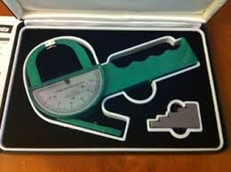
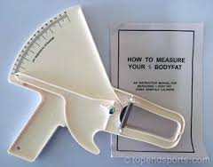
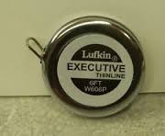
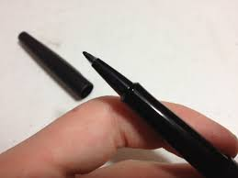
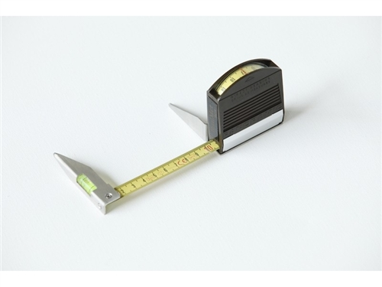
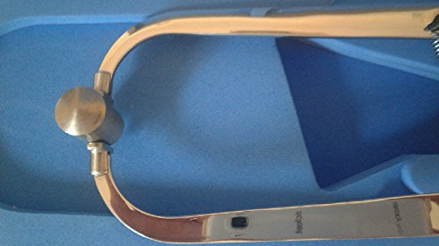
Skinfold Assessment: Equipment & Supplies
Lange & Slim Guide Skinfold Calipers only
Calibration Block/Dowel/Rod/Vernier Caliper
Anthropometric Tape Measure (preferably metal)
Segmometer (optional)
Fine tipped felt or Dermographic pen (white & black)
Record Sheet
Assessment Procedures Manual

Slide 79
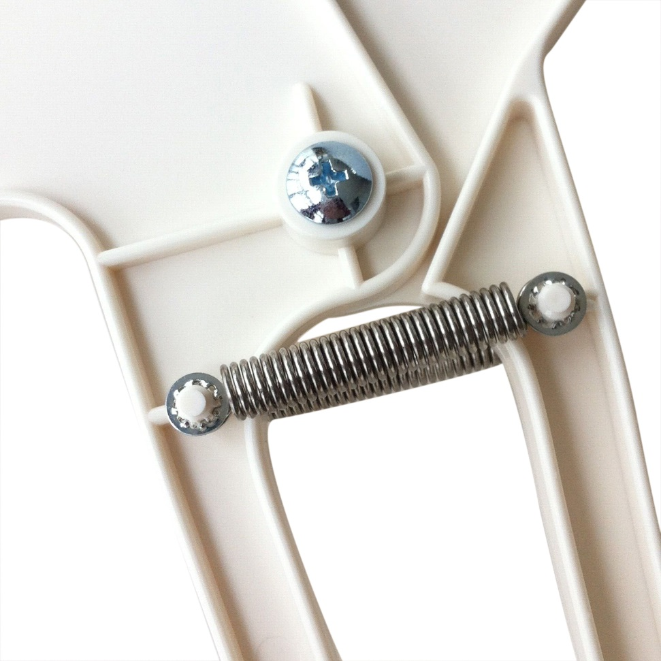
Skinfold Assessment: Maintenance Check
Caliper Springs- Not be distorted (slim guide)
Pivot Joint- Smooth operation
Indicator mechanism- clearly visible/not bent
Indicator Mechanism- Clearly visible/not bent
Jaw Alignment- Should be square to ensure full surface are can be applied

Slide 80
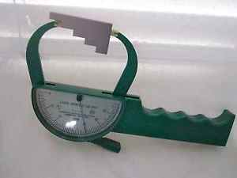

Skinfold Caliper Calibration: Jaw Gap
Caliper Jaw Gap
Calibration Block/Dowel/Rod/
Vernier caliper
Be sure indicator is on zero
If caliper jaw gap is off send caliper to manufacturer for repair or purchase new caliper

Slide 81
Skinfold Caliper Calibration: Spring Tension
Caliper spring tension should remain constant throughout the range of measurement; send caliper to manufacturer or replace old springs
Calipers spring tension should be calibrated every 2 years!
Currently working on developing standard foam “open cell” blocks or memory foam carpet padding samples for calibrating spring tension

Slide 82
Prior to Skinfold Assessment
Wrestlers must not exercise, take a shower, or sit in a sauna/steam or equivalent between their Hydration status assessment and the skinfold assessment. All of above mentioned will increased blood flow to the skin which will compromise the accuracy of the assessment.
Ensure the athlete’s skin is dry and lotion-free.
If the wrestlers skin is not dry for any reason use a dry cloth or towel to dry the areas of the body that will be skinfold tested.
It is recommended that Body Fat Assessors review their ethical and professional responsibilities prior to the skinfold assessment.

Slide 83
Preparing Wrestler Prior to Skinfold Assessment
Explain the skinfold assessment process to the wrestler and answer any questions/concerns.
Verbal consent should be obtained prior to beginning the skin fold assessment.
Athletes should be offered the option of having a friend or parent as chaperone especially is the Body Fat Assessor is not the same gender.

Slide 84
Skinfold Technique: Landmarking
All landmarks are identified and marked using a fine-tipped felt or dermographic marker before any measurements are made.
Landmarks are identifiable skeletal points which generally lie close to the body’s surface and are the “markers” which identify the exact location of the measurement site.
Landmarks are identified with the thumb OR index finger.
For accuracy of measuring and comfort of the athlete, the body fat assessor’s fingernails should be kept trim.

Slide 85
Skinfold Technique: Landmarking
Particular attention should be made to preserving a 90* angle between the assessor’s finger and the athlete’s skin surface to detect bony surfaces. without the skin being pulled out of its normal position.
Once a landmark is identified with your finger release to remove any distortion of the skin, then relocated and make your mark.
The mark is then re-checked to ensure that there has been no displacement of the skin relative to the underlying bone.

Slide 86
Skinfold Landmark
Skinfold Landmarks are marked with a cross
The long axis of the mark defines the direction of the skinfold and is used as a guide to ensure the thumb and index finger are equal distance when grasping the skinfold
The short axis mark defines the alignment of the Assessor’s index finger and thumb
Use a straight edge for marking skinfold landmarks (i.e., tape measure, small ruler, business card)

Slide 87
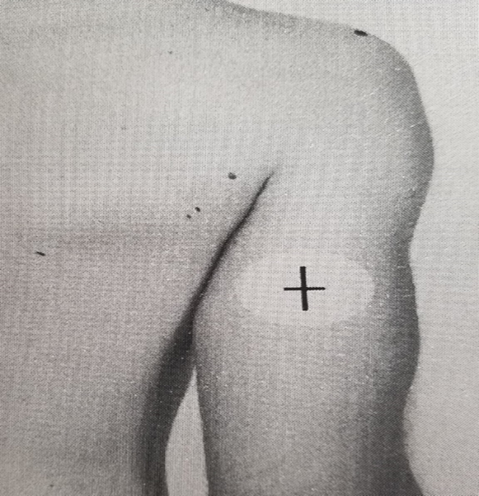
Marking- Landmarks & Measurement Sites
Marking landmarks: small identification marks ( -- * )
Marking measurement sites: Draw straight lines crossing at landmarked sites
Long axis identifies the direction to grasp skinfold AND a guide for aligning fingers
Short axis is used as a guide for aligning fingers
Notes:
How to hold the marker to get a straight line. Use tape, tiny ruler, business card, AS STRAIGHT-EDGE

Slide 88
LANDMARKING SEQUENCE SUMMARY
Positioning
Locate
Release and relocate
Mark
Final Check & Proceed
Notes:
Position the tools/equipment, recorder/proforma, athlete & yourself
Particular attention should be made to preserving a 90* angle between the assessor’s finger and the athlete’s skin surface to detect bony surfaces without the skin being pulled out of its normal position.
Once a landmark is identified with your finger release to remove any distortion of the skin, then relocated and make your mark (dot or a short line)
The mark is then re-checked to ensure that there has been no displacement of the skin relative to the underlying bone

Slide 89
Landmarking Sites
Males: 5 Landmark Sites
ACROMIALE
RADIALE
MID-ACROMIALE-RADIALE
SUBSCAPULARE
ABDOMINAL
Females: 4 Landmark Sites
ACROMIALE
RADIALE
MID-ACROMIALE-RADIALE
SUBSCAPULARE

Slide 90
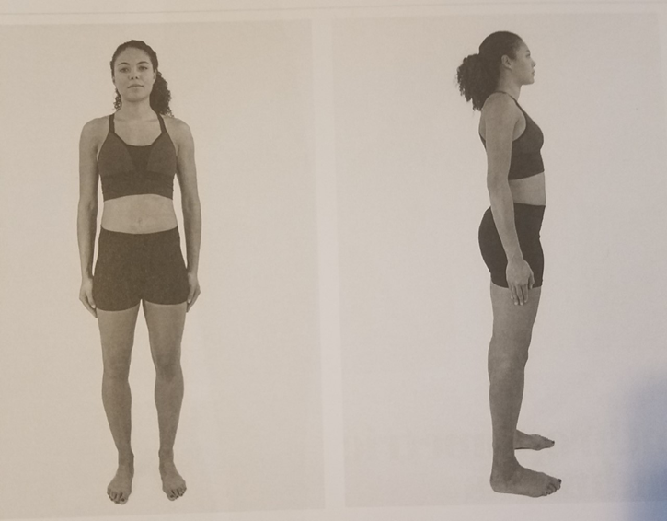
The Anthropometric position
Body, neck and head should be erect and facing forward, with the arms extended down on each side of the body,
Palms parallel to the body and thumbs pointing towards the front.
The legs are extended with the feet comfortably apart, but no more than hip width.

Slide 91
Skinfold Technique: Landmarking ACROMIALE
Definition: The point at the superior and lateral border of the acromion process, midway between the anterior and posterior boarders of the deltoid muscle when viewed from the side.
Subject Position: Relaxed position with the arms hanging by the sides.
Location: Standing behind and on the right side of the athlete palpate along the spine of the scapula to the corner of the acromion. Apply the straight edge of a pencil to the lateral aspect of the acromion to confirm the location of the boarder, if necessary. The landmark is a point on the most lateral and superior part of the border which is adjudged to be the mid-deltoid position when viewed from the side.

Slide 92
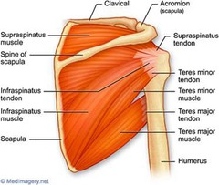
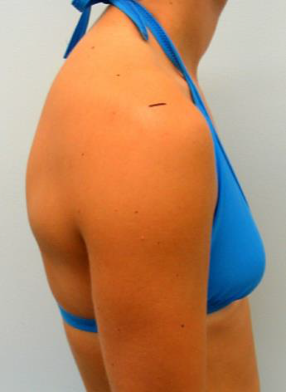
Landmark: ACROMIALE

Slide 93
Skinfold Technique: Landmarking RADIALE
Definition: The point at the proximal and lateral border of the head of the radius.
Subject Position: Relaxed position with the arms hanging by the sides in anthropometric position.
Location: Palpate downward into the lateral dimple of the right elbow. It should be possible to feel the space between the capitulum of the humerus and the head of the radius. Move your thumb distally onto the most lateral part of the proximal radial head. Mark with short line perpendicular to the long axis of the forearm.

Slide 94
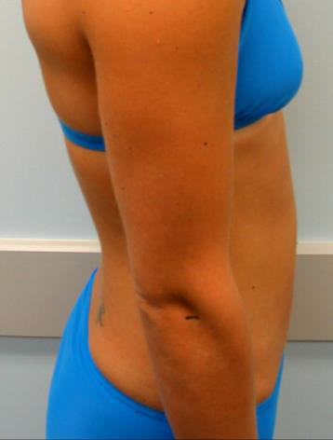
Landmark: RADIALE

Slide 95
Skinfold Technique: Landmarking MID-ACROMIALE-RADIALE
Definition: The mid-point of the straight line joining the Acromiale and the Radiale.
Subject Position: Relaxed position with the arms hanging by their side in anatomical position.
Location: Measure the linear distance between the acromiale and radiale landmarks. If a tape measure is used, be sure to hold it so that the perpendicular distance between the two landmarks is measured, rather than following the curvature of the skin. Place a small mark at the level of the mid-point between those two landmarks. Using a tape measure project this mark around to the posterior surface of the arm. Next, intersect the projected line with a vertical line in the middle of the arm when viewed from behind.

Slide 96
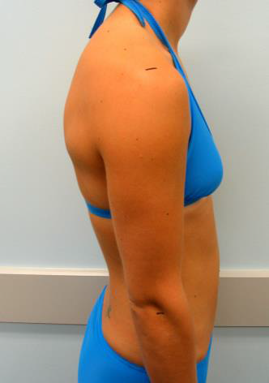
Landmark: MID-ACROMIALE-RADIALE

Slide 97
Skinfold Technique: Landmarking SUBSCAPULARE
Definition: The undermost tip of the inferior angle of the scapula.
Subject Position: Relaxed position with the arms hanging by the sides.
Location: Palpate the inferior angle of the scapula using your left thumb. Mark the undermost point as a dot when located. Next, draw a line 2 cm from the mark laterally downward at an angle of 45 degrees. Draw a second line, perpendicular to the first, to indicate the alignment of the finger and thumb when picking up the fold. If there is difficulty locating the inferior angle of the scapula, have the athlete slowly reach behind the back using the right arm. The inferior angle of the scapula should then be felt continuously as the hand is again placed by the side of the body .

Slide 98
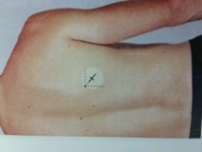
Landmark: SUBSCAPULARE

Slide 99
Skinfold Technique: Landmarking ABDOMINAL
Definition: The point 5 cm horizontally to the right hand side of the omphalion (midpoint of the navel)
Subject Position: Relaxed position with the arms hanging by the sides
Location: The site is identified by a horizontal measure of 5 cm, to the athlete’s right, from the omphalion

Slide 100
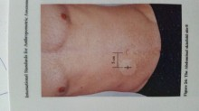
Landmark: ABDOMINAL

Slide 101
Skinfold Technique
Begin by having athlete standing in anthropometric position
Take all measurements on right side of body (exceptions include; injury, deformity, etc.).
Hold the skinfold caliper in the right hand while raising the skinfold with the thumb and index finger of the left hand using the prone grip (the back of the hand should be facing the measurer).
Position yourself so you are looking directly at the caliper dial to avoid errors from viewing from the caliper dial from a disadvantaged angle.
If you need a better view for very tall athletes use a box or step ladder. Remember never move the skinfold caliper for a better view move your head or body.

Slide 102
Skinfold Technique (cont.)
The skinfold is picked up at the marked site. The near edge of the thumb and index finger are in line perpendicular to the skinfold orientation.
The skinfold should be grasped and lifted (raised) so that a double fold of skin plus the underlying subcutaneous adipose tissue is held between the thumb and index finger of left hand.
The size of the fold should be the MINIMUM necessary to ensure that the two skin surfaces of the fold are parallel.
Hold the skinfold firmly but do not pinch to the point of pain.

Slide 103
Skinfold Technique (cont.)
The nearest edge of the contact faces of the caliper are applied 1 cm away from the edge of the thumb and finger.
Measure midway between the surface and the crest of the fold. As a guide, the center of the caliper faces should be placed at a depth of approximately mid-fingernail.
Allow the caliper jaws to gently come in contact with the skinfold. Release the caliper so that the thumb, index finger, and caliper spring tension is supporting the skinfold.

Slide 104
Skinfold Technique (cont.)
Measurement is recorded TWO seconds after the full pressure of the caliper is applied
Read the dial of the caliper to the nearest 0.5mm
Record three measurements at each site in rotation order.
Practice is necessary to ensure the same size of skinfold is grasped at the same location for repeated measures

Slide 105
Skinfold Technique (cont.)
If the difference between the three values is more than 1mm for a single site, the subject will need to wait 20 minutes for additional skinfold reading (this allows the skin to return to normal condition).
Example 1: If the triceps skinfold values are 10.0mm, next 10.5mm, and finally 11.0mm those 3 values are within 1.0 mm and would be acceptable.
Example 2: If the triceps skinfold values are 10.0mm, next 10.5mm and finally 11.5mm those 3 values are NOT within 1.0mm and would not be acceptable.

Slide 106
Skinfold Sights
Male
  Triceps
  Subscapular
  Abdominal
Female
  Subscapular
  Triceps

Slide 107


Triceps Skinfold
Arm relaxed hanging by side in anthropometric position
The Skinfold is measured vertically and parallel to the line of the upper arm, over the triceps muscle

Slide 108

Subscapular Skin Fold
Athlete assumes a standing position with arms relaxed by the side in anthropometric position
Skinfold is raised along a line running laterally and obliquely downwards at an angle (approximately 45°) as determined by the natural fold of the skin

Slide 109


Abdominal Skin Fold
Athlete assumes a standing position with arms relaxed by the side in anthropometric position
The skinfold is measured vertically. Make sure initial grasp is firm and broad. NOTE: Do Not place calipers in the navel

Slide 110
Special Circumstances
There are some people for whom the skinfold technique cannot be accurately taken (injury, deformity, extremely tight skin, large subcutaneous adiposity). To avoid both large errors and/or embarrassment contact IHSA for another option.

Slide 111
Body Fat Appeal
Rationale: Allow wrestlers the opportunity to pursue a more accurate/comprehensive body fat assessment when the 3-site skinfold technique proves to be insufficient for a particular “high risk” wrestler and/or circumstance.

Slide 112
When is Appeal Option Recommended?
Wrestler considering a wt. class that would put them below the minimum threshold
Multiple “varsity” wrestlers competing for same weight class (who goes up or down?)
Wrestler/coach isn’t satisfied with the results and another skinfold test isn’t likely going to change
Cannot obtain valid skinfold assessment (anatomical or mechanical reasons)
Wrestler/coach/parent request

Slide 113

Body Fat Appeal Options
Repeat Initial Skinfold Assessment
Hydrostatic “underwater” Weighing

Slide 114
Appeals Process Rules
Appeal must be filed w/in 7 calendar days of info appearing on the schools body fat results sheet
Can appeal ONE time
Can use a different tester
Use “Wrestling Weight Control Appeal Form”
Fax to IHSA
Results of appeal test will replace previous test, may not be appealed, and wrestler may not wrestle until results are posted
If Wrestler weighs less than 1.5% of the initial test the appeal is void and the results of the previous test are taken
IHSA reserves the right to re-test any wrestler

Slide 115
Final Appeal
Final Appeal: The school may file a final appeal for weight certification after their first certification date and on or before Friday of week 24 (Dec. 15th) on the IHSA Standardized calendar with approval of the IHSA administrator. A final appeal can only occur if the athlete wishing to appeal has not exceeded 1.5% weight loss per week each week from the date of the athlete’s first certification. This appeal would allow the wrestler to drop no more than one weight class from the original minimum result from the first test.

Slide 116
Website Data Entry
Calculations/Results

Slide 117

IHSA Website

Slide 118

Enter your ID # and Password

Slide 119


Check Personal Data

Slide 120

Enter Data

Slide 121

Adding a Wrestler

Slide 122

Input Data

Slide 123

Master Report

Slide 124
IHSA Quality Assurance Standards
Assessors are properly trained (i.e., ISAK Certified Instructor Level 3 or equivalent)
Validated protocols are used (i.e., ISAK Protocol)
Level of uncertainty is quantified (i.e., +- 1mm)
Assessment results are collected in a standardized format including all assessment details (IHSA data sheets & website entry)
Assessment results are returned to athlete/coach in a timely manner and in a form that is readily understood and interpreted (Master Report)

Slide 125

If you get stuck on this slide,
your browser’s pop-up blocker may be the cause.
There may be a bar at the top of this window asking if you would like to allow pop-ups for this site. Answer in the affirmative to proceed.
You can also go into the browser tools menu and allow pop-ups for www.ihsa.org.
Toolbars from Google, Yahoo, etc. may also be blocking pop-ups.

Slide 126

If you get stuck on this slide,
your browser’s pop-up blocker may be the cause.
There may be a bar at the top of this window asking if you would like to allow pop-ups for this site. Answer in the affirmative to proceed.
You can also go into the browser tools menu and allow pop-ups for www.ihsa.org.
Toolbars from Google, Yahoo, etc. may also be blocking pop-ups.

